Slide 1
Python
Day #5

Slide 2
Agenda
Working with Databases in Python
GUI Development using Tkinter
Miscellaneous Topics
Search and replace in files
Walking the directory tree
Connecting processes through pipes
The problem of starvation in network applications
Making the server multi-threaded
Python Flask
Configuring Atom for python projects

Slide 3
Agenda
Variable length arguments to functions
Working with XML
Unit Testing
Getting ready to test and debug
The unitest module
Writing test cases
Building a test suite
The setUp and tearDown methods
Using pdb module to debug

Slide 4
Working with Databases in Python
Should have mysql installed on the computer
Python connector should be installed as well
pip install mysql-connector-python
Basic invocation is as follows:
import mysql.connector
mydb = mysql.connector.connect(
host="localhost",
user="yourusername",
passwd="yourpassword"
)
print(mydb)

Slide 5
Variable length arguments for functions
The special syntax *args in function definitions in python is used to pass a variable number of arguments to a function. It is used to pass a non-keyworded, variable-length argument list.
The special syntax **kwargs in function definitions in python is used to pass a keyworded, variable-length argument list. We use the name kwargs with the double star. The reason is because the double star allows us to pass through keyword arguments

Slide 6
Working with XML
XML stands for eXtensible Markup Language.
It was designed to store and transport data.
It was designed to be both human- and machine-readable
XML modules in python
The minidom, or Minimal DOM Implementation, is a simplified implementation of the Document Object Model (DOM)
The ElementTree module provides a more "Pythonic" interface to handling XML and is a good option for those not familiar with the DOM.

Slide 7
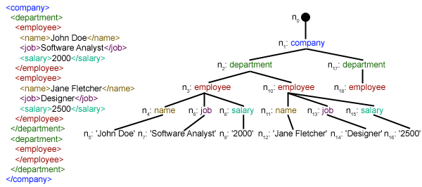
Working with XML
XML is an inherently hierarchical data format, and the most natural way to represent it is with a tree.

Slide 8
Using minidom
In order to parse an XML document using minidom, we must first import it from the xml.dom module. This module uses the parse function to create a DOM object from our XML file. The parse function has the following syntax:
xml.dom.minidom.parse(filename_or_file[, parser[, bufsize]])

Slide 9
Using ElementTree
Accessing objects and attributes with ElementTree more Pythonic compared to minidom
XML data is parsed as simple lists and dictionaries
Syntax:
tree = ET.parse('items.xml')

Slide 10
Writing to XML
ElementTree is also great for writing data to XML files. The code below shows how to create an XML file with the same structure as the file we used in the previous examples.
The steps are:
Create an element, which will act as our root element. In our case the tag for this element is "data".
Once we have our root element, we can create sub-elements by using the SubElement function. This function has the syntax:
SubElement(parent, tag, attrib={}, **extra)
Here parent is the parent node to connect to, attrib is a dictionary containing the element attributes, and extra are additional keyword arguments.

Slide 11
Writing to XML
Steps continued....
Although we can add our attributes with the SubElement function, we can also use the set() function, as we do in the following code. The element text is created with the text property of the Element object.
Create a string out of the XML tree, and we write that data to a file we open.

Slide 12
Finding XML elements
The ElementTree module offers the findall() function, which helps us in finding specific items in the tree.
It returns all items with the specified condition.
In addition, the module has the function find(), which returns only the first sub-element that matches the specified criteria.

Slide 13
Modifying XML elements
The attribute's name can be redefined by using the set(name, value) function.
The set function doesn't have to just work on an existing attribute, it can also be used to define a new attribute.

Slide 14
Creating new elements
The ElementTree module has more than one way to add a new element.
Using the makeelement() function, which has the node name and a dictionary with its attributes as parameters.
Using the SubElement() class, which takes in the parent element and a dictionary of attributes as inputs.

Slide 15
Deleting elements
Remove a node's attribute by using the pop() function.
The function applies to the attrib object parameter.
It specifies the name of the attribute and sets it to None.

Slide 16
The unittest Module
unittest module provides functionality to create python tests
It provides both test frame work and also a test runner
Requires:
You put your tests into classes as methods
You use a series of special assertion methods in the unittest.TestCase class

Slide 17
Structuring a complete test
Before you dive into writing tests, you’ll want to first make a couple of decisions:
What do you want to test?
Are you writing a unit test or an integration test?
Then the structure of a test should loosely follow this workflow:
Create your inputs
Execute the code being tested, capturing the output
Compare the output with an expected result

Slide 18
Example
For this application, you’re testing sum(). There are many behaviors in sum() you could check, such as:
Can it sum a list of whole numbers (integers)?
Can it sum a tuple or set?
Can it sum a list of floats?
What happens when you provide it with a bad value, such as a single integer or a string?
What happens when one of the values is negative?
def sum(arg):
total = 0
for val in arg:
total += val
return total

Slide 19
.py
PVM
.pyc
Byte Code

